Slide 2
WARM UP
Take out your DICKINSON chart!
We have more presentations today.

Slide 3
Realism
1855-1910
Keep it Real!
This literary movement focused on expressing the harshness of life
These stories were True and relatable…

Slide 4
Realism Authors
Slave Narratives
Whitman-
bold and confident
Wrote in Free Verse
Dickinson-
shy and reserved
Wrote in Quatrain structure, slant rhyme, irregular capitalization

Slide 5
Regionalism
Dates: 1870-1910
The literary movement which focused on expressing
- the characteristics,
-traditions,
-and customs
of a specific region in the U.S.

Slide 6
Regionalist Authors
Mark Twain- used dialect
example: Puddnhead Wilson
Kate Chopin- also used dialect and focused on setting!
example: Desiree’s baby

Slide 7
Naturalism
Man vs. nature
Survival and human instincts

Slide 8
What is Naturalism?
Naturalism was a literary movement from the 1880s to 1930s that used detailed realism to suggest that social conditions, heredity, and environment had inescapable force in shaping human character.

Slide 9
REALISM
More detailed, focused forms of REALISM:
Regionalism- Location- dialect, customs,etc.
Naturalism- Environment (physical or social)

Slide 10
What is Naturalism?
Applied scientific principles of objectivity and detachment to the study of human beings.
Influenced by Darwinism (natural selection) and psychology (Freud)
Posited that men were governed by heredity and environment.
Often depict man in conflict with nature, society, or himself.
Prominent from 1880-1920s

Slide 11
Tenets of Naturalism
1. Man vs. Nature- survival and survival of the fittest are key themes
2. The “Brute Within”- each individual has natural survival instincts
3. Nature is an indifferent force, not caring about humans
4. The environment/Society affects and determines individual lives
5. Humans have no hope. There’s no hope beyond the grave

Slide 12
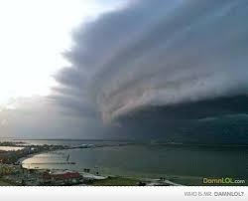
Naturalism
Specific Characteristics of Naturalist Stories:
Mythic situations – open sea, deserted island, wilderness, etc.
SURVIVAL- Fate is determined by forces beyond individual control.

Slide 13
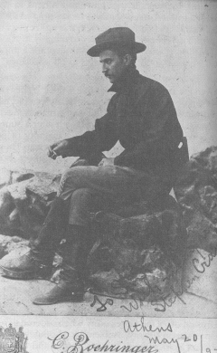
Naturalist Writers
Stephen Crane
Ambrose Bierce
Jack London
Charlotte Perkins Gilman
Edith Wharton

Slide 14
Why did Naturalism develop?
The swell of immigrants in the latter half of the 19th century, which led to a larger lower class and increased poverty in the cities
The prominence of psychology and the theories of Sigmund Freud
Pessimism in the wake of the Civil War and Reconstruction
Publication of Charles Darwin’s Origin of the Species

Slide 15
Modern Naturalism
https://www.youtube.com/watch?v=Bgw394ZKsis
https://www.youtube.com/watch?v=kYrmlP9MQus
Into the Wild
Man V Wild
How does this clip represent naturalism?
Are people a product of their environment?

Slide 16
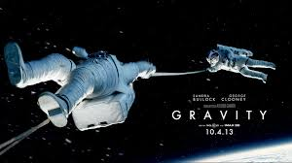
Other Pop Culture Connections

Slide 17
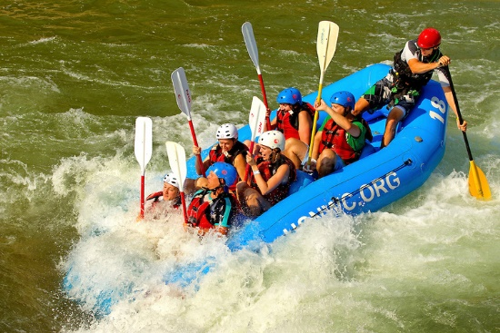
White Water Center

Slide 18
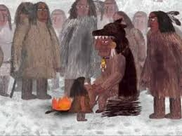
Jack London
The Law of Life
Notes:
R3: Analyze the impact of the author’s choices regarding how to develop and
relate elements of a story or drama (e.g., where a story is set, how the action is
ordered, how the characters are introduced and developed).
R4: Determine the meaning of words and phrases as they are used in the text,
including figurative and connotative meanings; analyze the impact of specific
word choices on meaning and tone, including words with multiple meanings or
language that is particularly fresh, engaging, or beautiful. (Include Shakespeare
as well as other authors.)
R5: Analyze how an author’s choices concerning how to structure specific parts of
a text (e.g., the choice of where to begin or end a story, the choice to provide a
comedic or tragic resolution) contribute to its overall structure and meaning as
well as its aesthetic impact.
R9: Demonstrate knowledge of eighteenth-, nineteenth- and early-twentieth-century
foundational works of American literature, including how two or more texts from
the same period treat similar themes or topics.
W2b & c: Develop the topic thoroughly by selecting the most significant and relevant
facts, extended definitions, concrete details, quotations, or other information
and examples appropriate to the audience’s knowledge of the topic.
c. Use appropriate and varied transitions and syntax to link the major sections
of the text, create cohesion, and clarify the relationships among complex
ideas and concepts.
W3: Write narratives to develop real or imagined experiences or events using
effective technique, well-chosen details, and well-structured event sequences
OBJ: Develop stories with naturalism characteristics
Modeling – use the modern examples/article on real man vs. nature elements
Teacher guided notes
Ind practice: writing own story
Closure: exit ticket, choral answer!

Slide 19
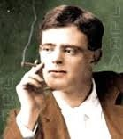
The Author: Jack London
This guy was amazing.
Called to adventure – poor, laborer in many industries
At 16 – oyster pirate! ARG!
Seal hunting at 17. Alaska!
Arrested for being homeless!
True rags to riches story.

Slide 20
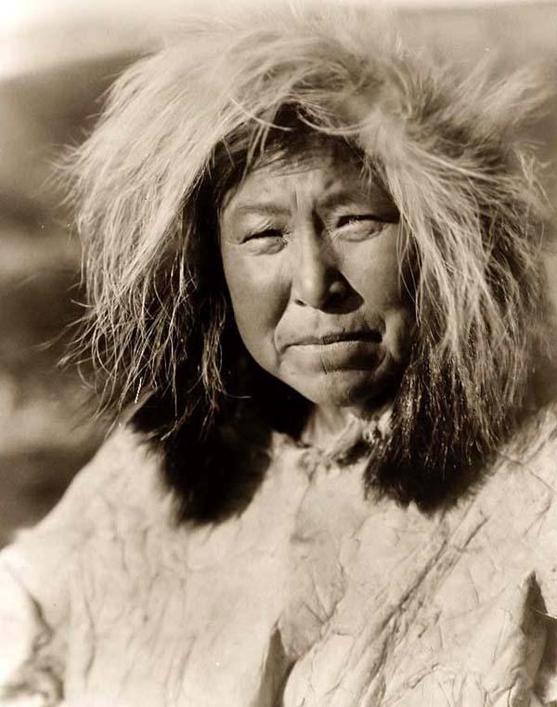
Law of Life
Pg. 770
Eskimo Tribe
Survival of the Fittest
The Weak were left behind
Even family…
In the Arctic Tundra, there’s no time for people who can’t take care of themselves…
Find out what happens to old Kookoosh!
Read this story- Then we will discuss it-

Slide 21
BEFORE READING…
What does today’s culture think about death?
How does today’s culture view the elderly?
What are some specific examples?

Slide 22
Answer these Questions- you will turn this in
Describe the conditions of Life for the tribe.
How does Koskoosh die?
How does the tribe view the elderly?
What is the task of every living thing in nature?
Find evidence (specific lines) that show elements of Naturalism.
Who is the speaker in this story? What perspective is it told from?
What event did Kookoosh witness as a teen that affected him (and becomes ironic later)?
What do you think of the conclusion of the story?

Slide 23
Creative Writing Closure
Take an experience of your own (real) and then put yourself in that moment or in a different setting or situation. Write the beginning of an adventure story. Survival Story!
Ex… I once had heat stroke hiking in Colorado. I’m going to change my setting and put me in a stranded life boat after a ship sank. I’m hungry, thirsty, etc… same as I felt in Colorado. Use what you know to write what you WANT. Use imagery, figurative language, tone, mood, etc.

